Slide 1

Insight
Step 2
Human-Computer Interaction
Master’s Degree in Artificial Intelligence
Spring Semester
2022-23

Slide 2
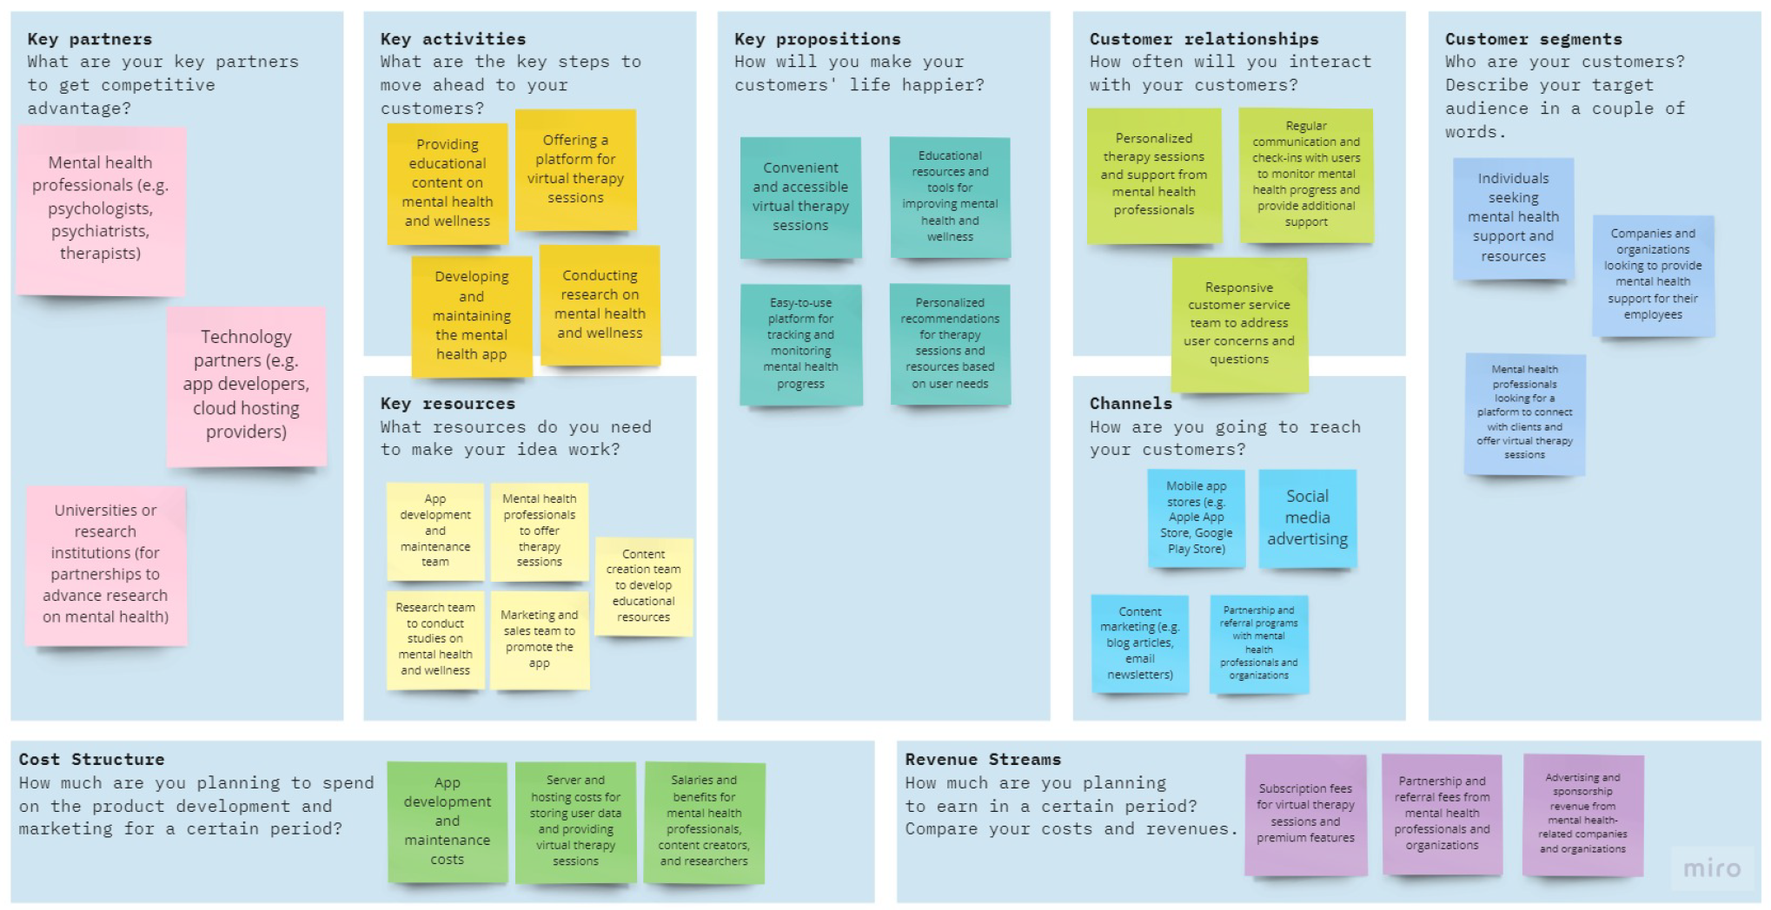
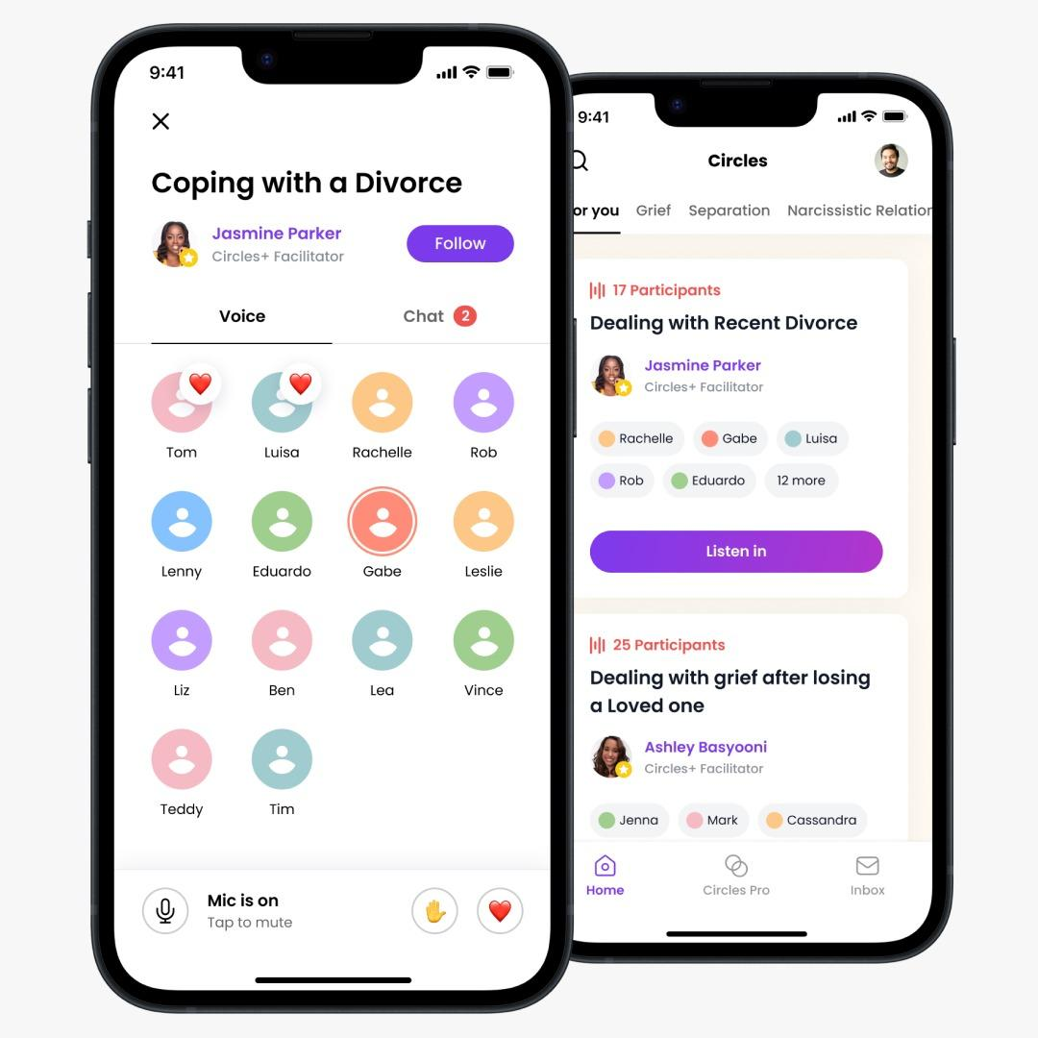
Introduction
After the state of the art, and the planning in head, we are on our way of making Insight into a reality, through 2 main steps :
Prototyping
Business Model Canvas

Slide 3
Insight Planning
Ideation and Brainstorming
Contextualization and Planning tasks
Technical production of Insight
Testing and Correcting
March
March - April
April - May
May - June
23 March - Step 1
4 May - Step 2
1 June - Step 3
Ideation, Brainstorming, Context and Tasks Planning
Online Support Groups
Insight Team
Self-care
Chatbot

Slide 4
Dividing the teams
Online Support Groups Team
Self Care Unit Team
Chatbot Team
Each team is working separately on the prototype taking in consideration a deadline that we agreed upon which is the 15/05/22.
The final prototype will then take into consideration the prototypes made by the different teams.
Then for the final prototype, there will be two professionals that could give us their reviews and we must then do the corresponding changes.

Slide 5


Prototyping Tool : FlutterFlow
FlutterFlow is a browser-based visual development platform to create apps based on Flutter.
Allows creating mobile and web applications using a drag-and-drop interface.
Aims to simplify and speed up the app development process.
Providing a user-friendly interface for building high-quality, cross-platform applications.
FlutterFlow will help us develop the prototypes of the units : Support groups and self care unit.

Slide 6
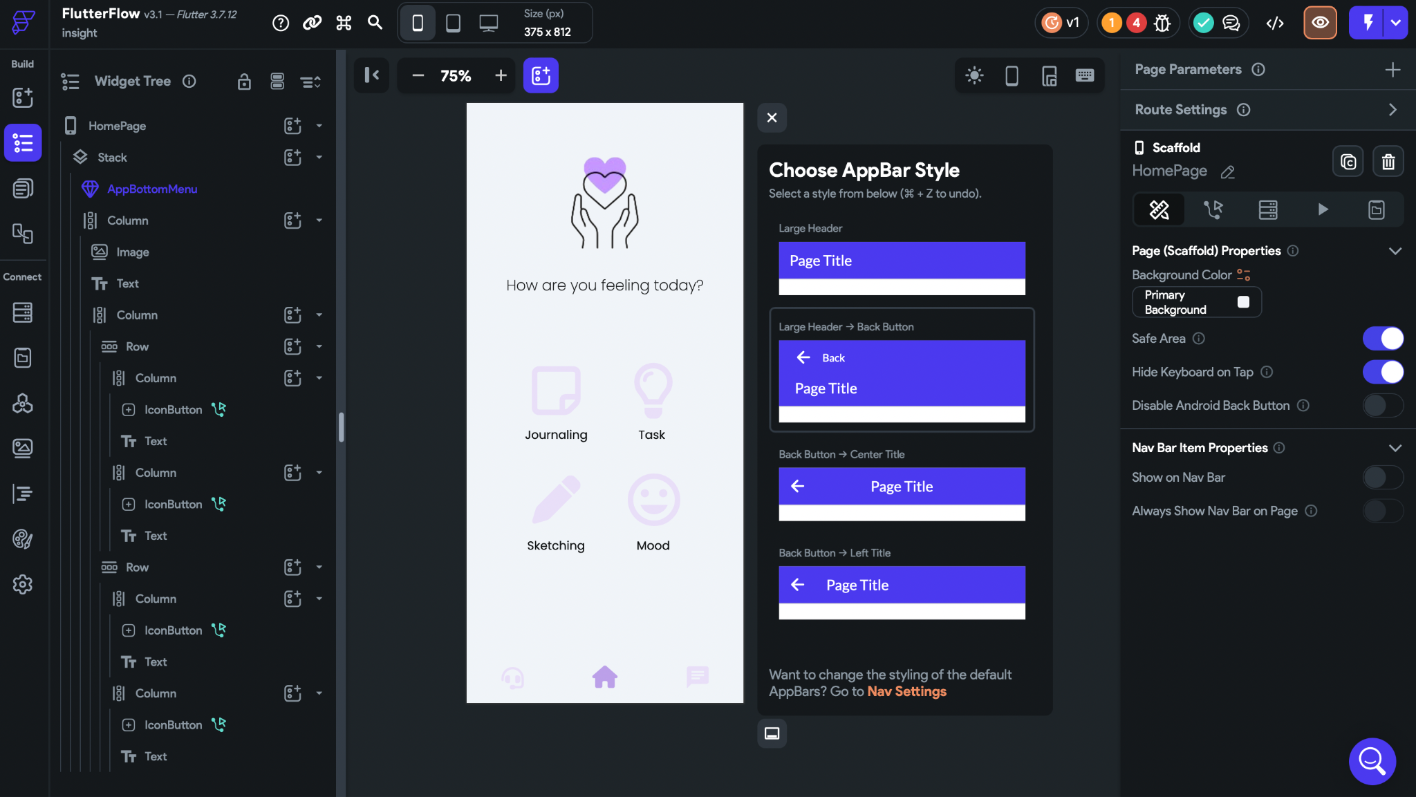

Slide 7
Prototyping Tool: Firebase
It is a set of backend cloud computing services and applications.
In Firebase the user is able to create databases, use services, authentication, and integration
Here, we use Firebase to create the databases useful to manage the chats.
For instance, in the chatbot interface we will have a database containing the messages the user had with the AI.
Each message is defined by a document, which contains 3 fields: the text of the message, the time stamp when the message was sent, and the user name.

Slide 8
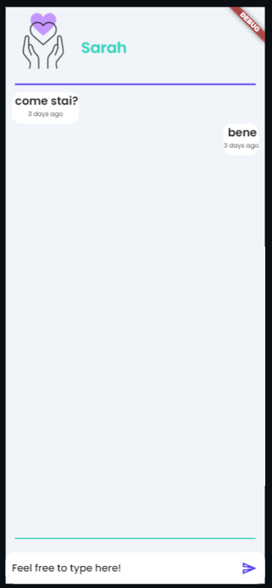
Chatbot
On the left the current interface for the chatbot.
Eventually, the user will be able to type on the textbox below, and the message will be saved in the Firebase database as a document containing the following information:
text → the content of the message
ts → the time stamp when the message was sent
user → the name of the user who sent the message
By taking the last message as input, the application will do a call to openAI so to use chatGPT to answer the user’s sentence.
Right now, we didn’t really focus on the AI part yet, but we saw that flutterflow is optimized to use many APIs, including the openAI one.
Instead, the structure of the interface, and the development of the backbone structure of how the messages are organized is almost complete.

Slide 9
Business Model Canvas
Definition
It’s a visual representation of a business model, highlighting all key strategic factors.
Other than providing a general overview of the business model, these canvases enable companies to visualize and analyze their strategy.
Why using a BMC ?
Collaborative brainstorming with the team was a crucial component of the BMC as it fostered productive discussions among team members
It helped us define our value proposition and what makes us different than the competitors. It helped us define the cost structure of our application and the revenue streams (how are we going to earn through the use of the application) and finally it made us develop a better understanding of the project.

Slide 10
Business Model Canvas of Insight

Slide 11
Future Plans
The different teams will be finishing up their prototypes in the 15 of may.
The different units prototypes will be reassembled into one prototype.
The functional prototype of the application will be shared with two professionals to get their reviews and feedbacks.
The overall remarks and feedbacks will be then taken into consideration to make the adequates changes.
The final product will be then ready to be tested by our main user that we defined previously in the step 1.

